Slide 1



STIs in PrEP Users: Are We Propelling the Epidemic?
Jean-Michel Molina, MD
University of Paris and Saint-Louis Hospital, INSERM U944, France
HIV testing and Management in the Era of PrEP

Slide 2
Disclosures
Advisory boards: Gilead, Merck, ViiV, Sanofi
Research grants: Gilead
Notes:
2

Slide 3
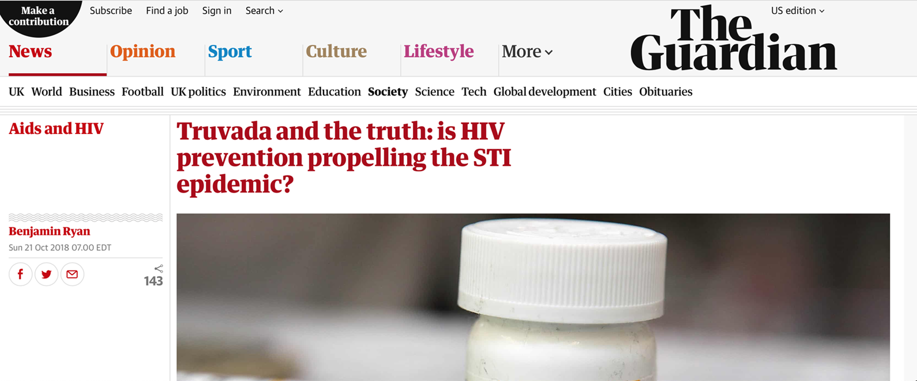
Notes:
3

Slide 4
The Success of ART for
Treatment and Prevention of HIV
Combined ART for the treatment of HIV-infection
Improved regimens to overcome resistance
ART for prevention of HIV transmission
ART for all HIV-infected patients regardless of CD4 counts
PrEP for HIV-negative at risk individuals
  Reduction in perception of risk of HIV/AIDS/death: risk compensation (lower condom use)
  STIs: new priority in those with or at risk for HIV
Hammer et al NEJM 1997, Cohen et al NEJM 2011; Lundgren et al. NEJM 2015, Grant et al. NEJM 2010

Slide 5
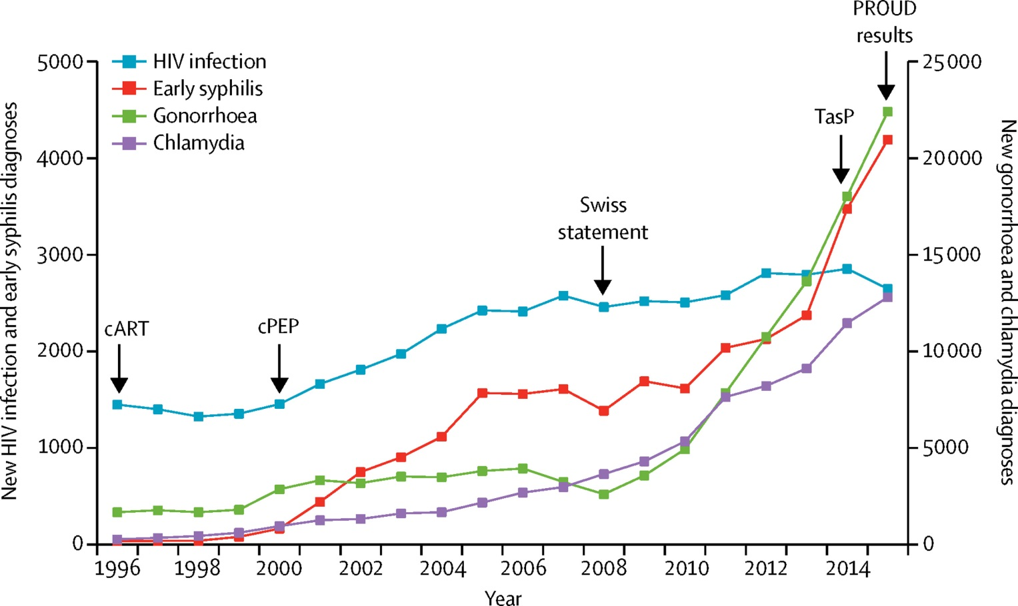
New Diagnoses of STIs from 1996 to 2015 in MSM in England
Figure 10
Unemo M et al. Lancet Infect Dis 2017
Notes:
New diagnoses of HIV infection, early syphilis, gonorrhoea, and chlamydia
Data are new diagnoses from 1996 to 2015 in men who have sex with men (MSM) in England.^{402–406} Early syphilis includes primary, secondary, and early latent infections. New diagnoses of bacterial STIs and HIV were stable immediately after the introduction of cART and cPEP. Syphilis and HIV increased from 2000 onwards. Publication of the Swiss statement⁴⁰⁷—that people taking cART with suppressed viral load do not need to use condoms—coincided with increases in new diagnoses of gonorrhoea and chlamydia and further increases in syphilis, but no change in HIV infections. These trends have continued since the introduction of the TasP recommendation and the PROUD trial.⁴⁰⁸ PROUD=PRe-exposure Option for reducing HIV in the UK, immediate or Deferred trial. cART=combination antiretroviral therapy. cPEP=combination post-exposure prophylaxis. TasP=treatment as prevention.

Slide 6
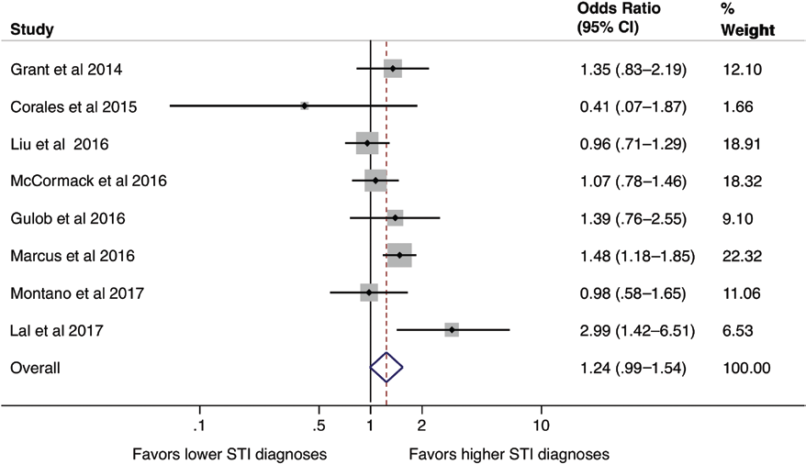
Meta-Analyis of Effect of PrEP on STIs Diagnosis among MSM
Significant increase in any rectal STI diagnosis (OR: 1.39, 95% CI: 1.03-1.87)
Significant increase in rectal chlamydia (OR: 1.59, 95% CI: 1.19-2.13)
Increase in STIs rates in more recent studies (OR: 1.47, 95% CI: 1.05-2.05)
Traeger MW et al. CID 2018
Notes:
Decreased condom use could lead to increase in STIs
Traeger et al conducted a sytematic review of of open-label studies published until August 2017 in the context of Daily prEP for MSM
16 observational studies and 1 open-label trial with a total of 4388 participants reported STI prevalence
The limitations is that 11 studies were conducted in the US and all but 2 in high income countries

Slide 7

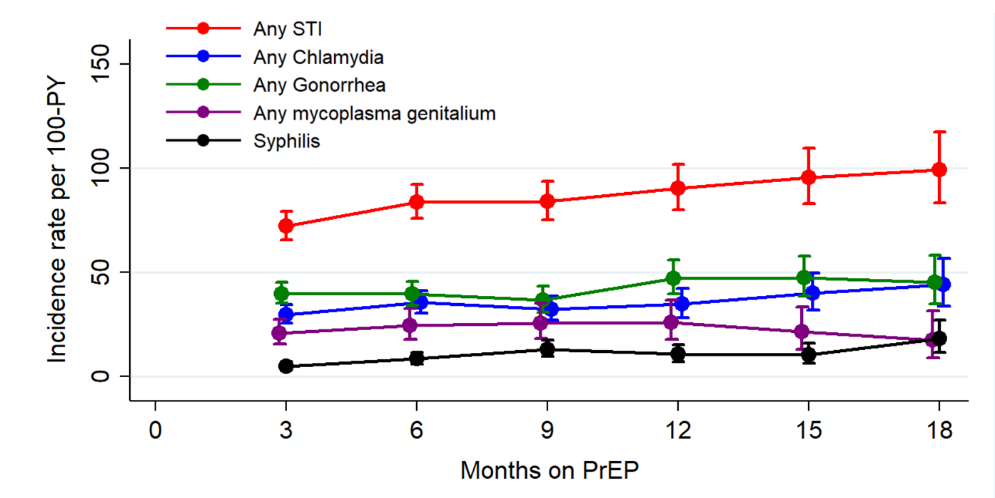
Incidence of Bacterial STIs
Among MSM on PrEP in Paris
26%
23%
Increase in incidence of +38% per year (P<0.001)
Trends assessed in piecewise exponential survival models
Molina et al. 10th IAS 2019, July 23 Mexico City, Mexico

Slide 8
STI Incidence Before/After PrEP among MSM
1378 participants of the PrEPX study in Australia with pre-enrollment testing data
Mean follow-up of 1.1 years
 | STI Incidence 1 year before Per 100 PY | STI Incidence Post Entry Per 100 PY | Incidence Rate ratio (95% CI) | Adjusted IRR* (95%CI)
All | 69.5 | 98.4 | 1.41 (1.29-1.56) | 1.12 (1.02-1.23)
PrEP-Exp (n=541) | 92.4 | 104.1 | 1.13 (0.99-1.28) | 1.05 (0.92-1.19)
PrEP-Naive (n=837) | 55.1 | 94.2 | 1.71 (1.49-1.96) | 1.21 (1.06-1.39)
*Adjusted for testing frequency
Traeger M. et al, JAMA 2019;321:1380

Slide 9
STIs in PROUD
Caveat
Number of screens differed between the groups:
e.g. Rectal gonorrhoea/chlamydia
974 in the IMM group and 749 in the DEF
Follow-up: 243 PY (immediate arm) and 222 PY (deferred arm)
Incidence: 62.5 (95% CI: 56.5-68.6) /100 PY immediate arm 55.8 (95% CI: 49.3-62.4) /100 PY deferred arm
Mc Cormack et al Lancet 2016
Notes:
57% participants in the immediate group had an STI at some point in follow-up, and 50% of deferred participants.
35% immediate and 32% deferred had a rectal infection at least once during follow-up. NB the numbers in the abstract have been corrected.
9

Slide 10
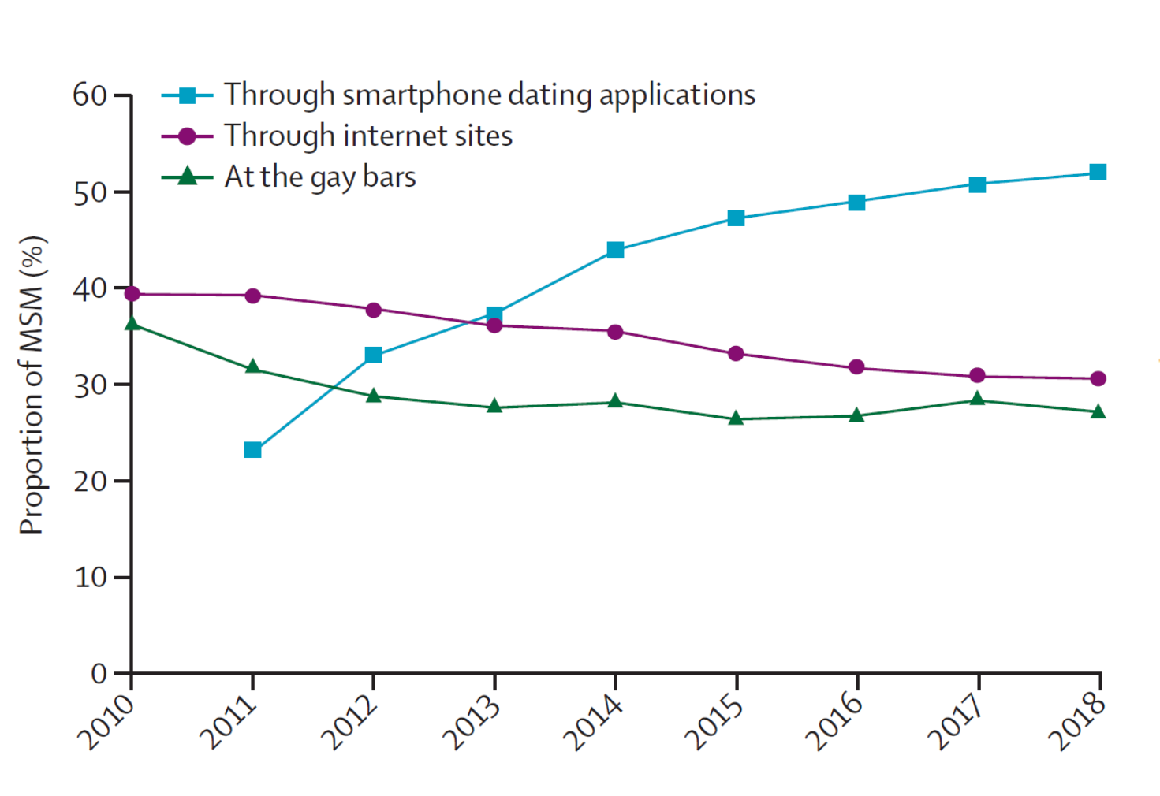
Means of Seeking Casual Sex Partners Among MSM in Australia
Chow EPF et al Lancet HIV 2019

Slide 11
How to Contain the STIs Epidemic ?
A, B and C: promotion of condom use
  - Counseling and behavorial interventions
Vaccines
  - Viral STIs (hepatitis A and B, HPV)
  - Bacterial STIs (gonorrhea, chlamydia, syphilis)
Antibiotic Prophylaxis
Test and Treat
  - Testing for STIs in high risk individuals
  - Treatment and the emergence of AB resistance
Partner notification and treatment
Notes:
There are no magic bullet and successful efforts will likely require sustained and multiple approaches

Slide 12
Partners not Condom Use Drive STIs Rates
PrEPX: Multisite, open-label PrEP study in Australia
4275 participants (98.5% MSM) enrolled (July 2016-April 2018)
STI incidence of 91.9 /100 PY and 2058 pts in a multivariable analysis
Predicting Factors of STIs | aOR | 95% CI | p
Age (5 years increase) | 0.94 | 0.90-0.97 | < 0.001
No. anal sex partner in last 6 months (< 5 vs. >10) | 1.91 | 1.48-2.46 | < 0.001
Group sex (monthly vs none) | 1.45 | 1.15-1.83 | 0.002
Condom use (never vs always) | 1.31 | 0.88-1.97 | 0.18
Traeger M. et al, JAMA 2019;321:1380
Notes:
12

Slide 13
Distribution of Participants and STI Diagnoses by Number of Infections
25% of Participants Accounted for 76% of all STIs
Traeger M. et al, JAMA 2019;321:1380
Notes:
13

Slide 14
How to Contain the STIs Epidemic ?
A, B and C: promotion of condom use
  - Counseling and behavorial interventions
Vaccines
  - Viral STIs (hepatitis A and B, HPV)
  - Bacterial STIs (gonorrhea, chlamydia, syphilis)
Antibiotic Prophylaxis
Test and Treat
  - Testing for STIs in high risk individuals
  - Treatment and the emergence of AB resistance
Partner notification and treatment
  -

Slide 15
Cross-Protection against Gonorrhea with Meningococcal Vaccine
Outer Membrane Vesicle meningococcal group B vaccines may affect the incidence of gonorrhea
  - 31% reduction of gonorrhea in a case-control study in NZ
  - Similar ecological data in Cuba, Norway and Canada
80-90% genetic homology in primary sequences between NG and NM OMV proteins
Meningococcal B vaccine (Bexsero°): 2/3 recombinant proteins shared with NG (including OMV Ag from NZ vaccine)
Ab generated by OMV vaccination: IgG but also IgM and IgA
Petoussis-Harris et al. Lancet 2017; Folaranmi CID 2017

Slide 16
How to Contain the STIs Epidemic ?
A, B and C: promotion of condom use
  - Counseling and behavorial interventions
Vaccines
  - Viral STIs (hepatitis A and B, HPV)
  - Bacterial STIs (gonorrhea, chlamydia, syphilis)
Antibiotic Prophylaxis
Test and Treat
  - Testing for STIs in high risk individuals
  - Treatment and the emergence of AB resistance
Partner notification and treatment

Slide 17
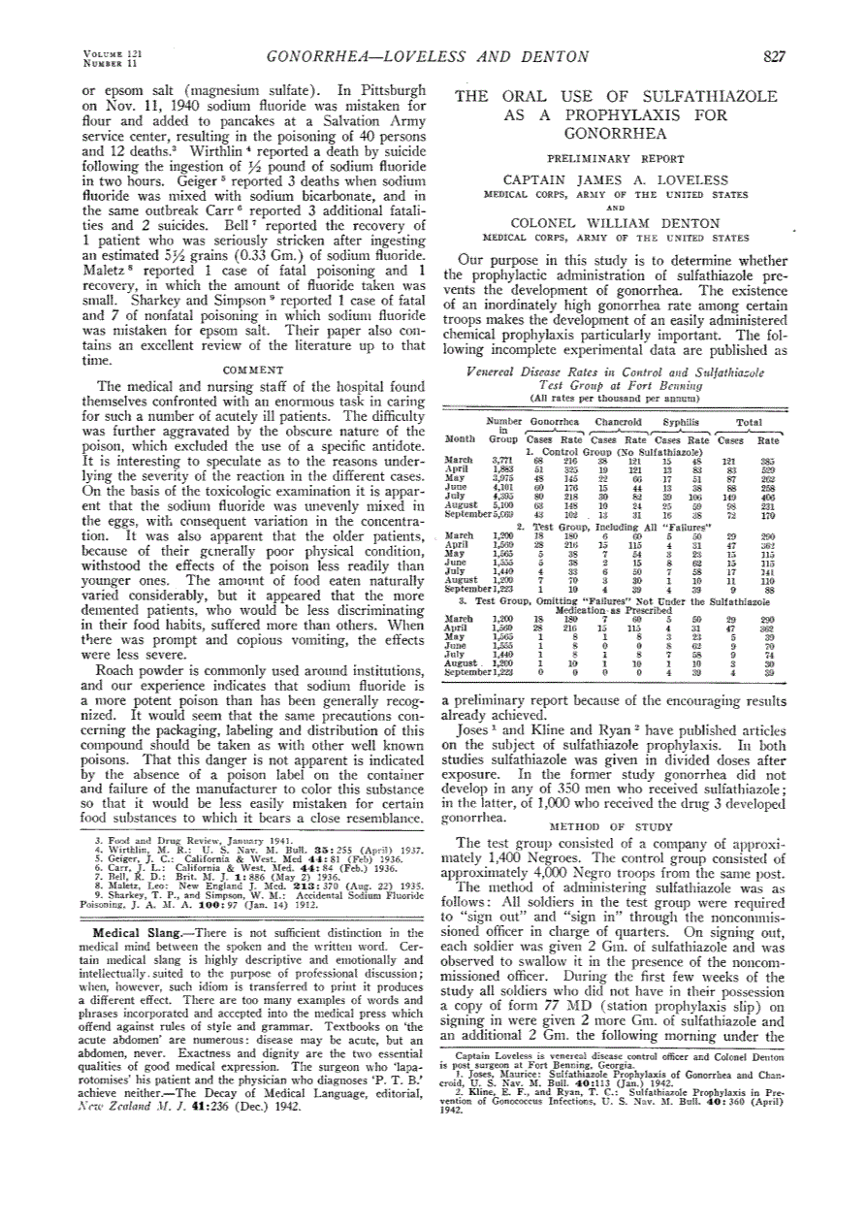
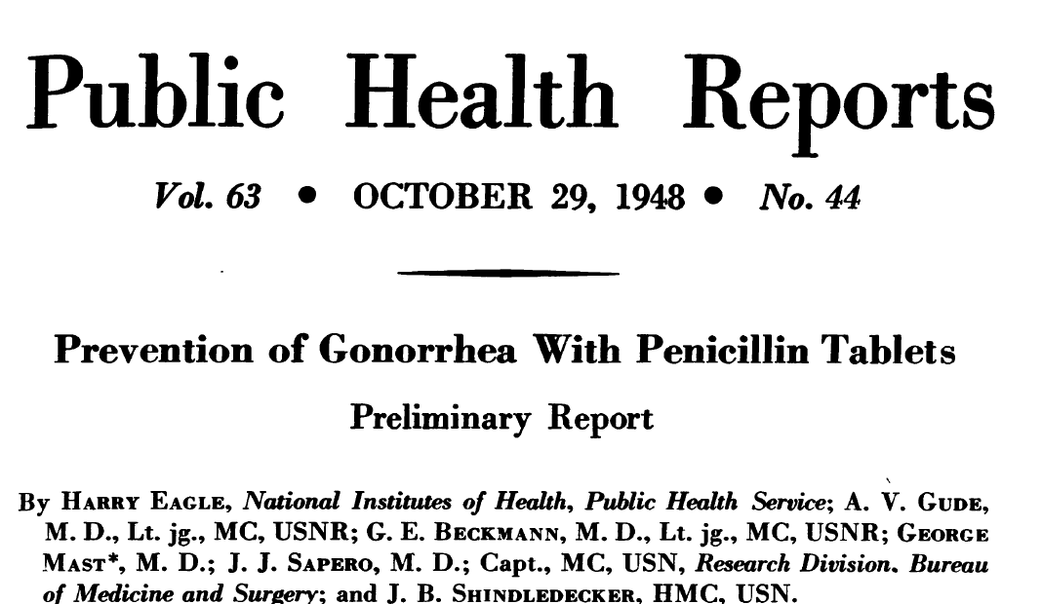
AB Prophylaxis for STIs: A New Strategy ?
JAMA 1943
Sulfathiazole was very effective: not a single case of chancroid in 450 men and a single case of GC
which proved to be refractory to treatment with sulfonamides !
Notes:
Discouraged by the rate of veneral disease in the crew of ships this dose was given to 350 men in Manilla sulfathiazole was given as post-exposure prophylaxis (3 doses in a single day) and this dose was given to 450 service man, no further cases of chancroid and a single case of gonorrhea but this case proved to be refractory to all sulfonamides derivatives

Slide 18

Doxycycline PEP in MSM
www.ipergay.fr
Randomized Open-Label Trial
On Demand PEP with Doxycycline (200 mg, 24h after sex)
N=116
HIV-negative high risk MSM
Enrolled in the ANRS IPERGAY Open-label extension study
No contra-indication to Doxy
No PEP
N=116
* < 6 pills/week to limit AB exposure: Use of a median of 6.8 pills/month per pt
  Visits: Baseline and every 2 months with serologic assays for HIV and syphilis and PCR assays for CT and NG in urine samples, anal and throat swabs
Molina et al Lancet ID 2018
Notes:
18

Slide 19

Incidence of Gonorrhea
(ITT Population)
0.5
0.4
Log-rank test p=0.52
0.3
No PEP
Cumulative probability of first STI
0.2
PEP
0.1
0
0
2
4
6
8
10
months
No at risk : No PEP
PEP
116
116
112
114
103
109
92
97
64
71
9
19
Median follow-up of 8.7 months (IQR: 7.8-9.7): 47 subjects infected
25 in no PEP arm (incidence: 34.5/100 PY), 22 in PEP arm (incidence: 28.7/100 PY)
Hazard Ratio: 0.83 (95% CI: 0.47-1.47, p=0.52)
Notes:
19
19

Slide 20
Incidence of Chlamydia
(ITT Population)
0.5
0.4
Log-rank test p=0.003
0.3
Cumulative probability of first STI
No PEP
0.2
0.1
PEP
0
0
2
4
6
8
10
months
No at risk : No PEP
PEP
116
116
112
114
102
111
93
105
68
84
9
22
Median follow-up of 8.7 months (IQR: 7.8-9.7): 28 subjects infected
21 in no PEP arm (incidence: 28.6/100 PY), 7 in PEP arm (incidence: 8.7/100 PY)
Hazard Ratio: 0.30 (95% CI: 0.13-0.70, p=0.006)
Notes:
20
20

Slide 21
Incidence of Syphilis
(ITT Population)
0.5
0.4
Log-rank test p=0.04
0.3
Cumulative probability of first STI
0.2
No PEP
0.1
PEP
0
0
2
4
6
8
10
months
No at risk : No PEP
PEP
116
116
114
116
110
115
102
107
74
83
7
21
Median follow-up of 8.7 months (IQR: 7.8-9.7): 13 subjects infected
10 in no PEP arm (incidence: 12.9 / 100 PY), 3 in PEP arm (incidence: 3.7 / 100 PY)
Hazard Ratio: 0.27 (95% CI: 0.07-0.98, p<0.05)
Notes:
21
21

Slide 22
Summary of Doxycycline PEP
No effect on Gonorrhea
Strong reduction (70-73%) in Chlamydia and Syphilis incidence
Acceptable safety profile with mild/moderate GI AEs
Analysis of antibiotic resistance very limited
Impact on human microbiome not assessed
Long-term benefit of PEP remains largely unknown
Antibiotic prophylaxis for STIs NOT recommended
Additional studies to be conducted to assess benefit/risk ratio
Molina et al Lancet Inf Dis 2018
Notes:
22

Slide 23
What is Next ?
Canada: Pilot studies with daily doxycycline in MSM to prevent syphilis
Australia: Syphylaxis study: impact of daily doxycycline on the incidence of syphilis in PrEP users in Sydney
USA : Spinelli et al. STI 2019: Grindr survey in SF in 1300 MSM High acceptability of PEP for STIs: 84%
  DoxyPEP study among MSM on PrEP or living with HIV
France
  New Doxy PEP study in the ANRS Prevenir PrEP study in MSM with the evaluation of the Meningococcal B vaccine against gonorrheae
Notes:
23

Slide 24
How to Contain the STIs Epidemic ?
A, B and C: promotion of condom use
  - Counseling and behavorial interventions
Vaccines
  - Viral STIs (hepatitis A and B, HPV)
  - Bacterial STIs (gonorrhea, chlamydia, syphilis)
Antibiotic Prophylaxis
Test and Treat
  - Testing for STIs in high risk individuals
  - Treatment and the emergence of resistance
Partner notification and treatment
  -

Slide 25
STIs Testing Guidelines for MSM
Everyone with symptoms
Asymptomatic: At least annually and every 3 months if multiple sex partners or recent bacterial STIs
  HIV Ag/Ab serology if HIV-negative
  Syphilis serology
  Chlamydia, Gonorrhea
    Urethral infection (NAAT)
    Rectal infection (NAAT)
    Pharyngeal infection gonorrhea (NAAT)
  Hepatitis A, B, C serology
No recommendation to test asymptomatic MSM for M. genitalium
CDC 2017, BHIVA 2017 , France 2018, MMWR STD Treatment Guidelines 2015

Slide 26
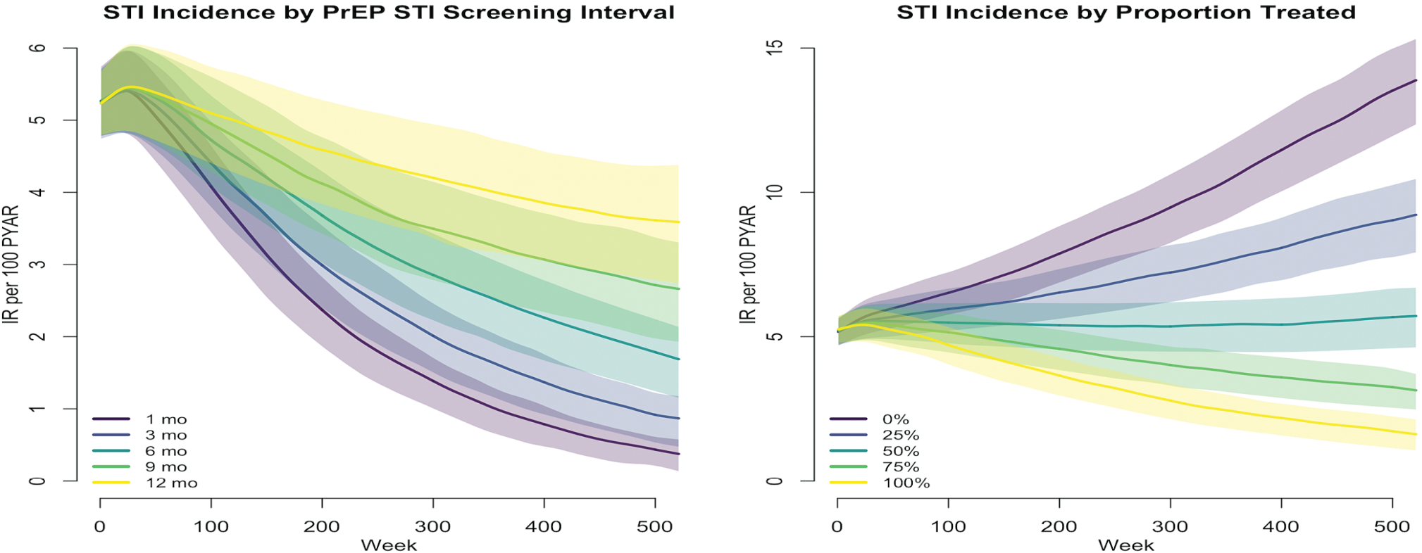
Impact of Testing Frequency for STIs among MSM using PrEP
Over the next decade, 40% of NG and CT infections could be averted
Jenness et al CID 2017
Notes:
Improving time to treatment could potentially reduce population prevalence by reducing exposure to uninfected partners
Only if effecetive partner notification or high rates of retesting if not rapid reinfection from exisintg partners (50-75% of partners likely to be infeceted with NG and CT)

Slide 27

No Increase in Syphilis in France among
HIV negative MSM since 2016
MSM: 81% of all cases and 36% with HIV co-infection
1600
No. of Syphilis cases reported
1400
MSM
1200
1000
Heterosexual men
800
600
Heterosexual women
400
200
Same sites
0
2010
2011
2012
2013
2014
2015
2016
2017
Ndeikoundam N, et al Eurosurveillance 2019
Lot F. Journées SPILF SFLS SPF Mars 2019 : Santé publique France, réseau RésIST, 2010-2017

Slide 28
How to Contain the STIs Epidemic ?
A, B and C: promotion of condom use
  - Counseling and behavorial interventions
Vaccines
  - Viral STIs (hepatitis A and B, HPV)
  - Bacterial STIs (gonorrhea, chlamydia, syphilis)
Antibiotic Prophylaxis
Test and Treat
  - Testing for STIs in high risk individuals
  - Treatment and the emergence of resistance
Partner notification and treatment
  -

Slide 29
Expedited Treatment of Sex Partners Increases Partner Notification in MSM
Impact of ETP on self-reported partner notification among MSM in Peru
173 MSM with symptomatic (n=44) or asymptomatic (n=129) GC/CT
Randomized to receive standard counseling or counseling + ETP (400mg cefixime + 1g azithromycin)
Primary outcome: self-reported notification at 14-day follow-up visit
Self-Reported Partner Notification | ETP | Standard Partner Referral | Odds Ratio 95% CI
At least one partner | 69/83 (83.1%) | 42/72 (58.3%) | 3.52 (1.68-7.39)
Stable partner | 80.9% | 51.6%
Casual partner | 54.8% | 33.3%
Recurrent GC/CT | 5/83 (6%) | 4/72 (5.6%)
Clark J et al BMC Medicine 2017
Notes:
29

Slide 30
Summary
ART/PrEP implementation: high rates of condomless sex and STIs did not undermine high efficacy against HIV
New interventions to reinforce individual perception of STIs risk and promote condom use
Frequent testing, early diagnosis, appropriate treatment and better partner notification should help reduce STIs incidence
New behavioral and biomedical strategies to be tested
STIs should not be an excuse to deny PrEP access
Community and individuals empowerment is key
More research to meet 2030 WHO/UNAIDS targets: reduce incidence of HIV and STIs by 90%

Slide 31











Acknowledgments
@jmmolinaparis
Notes:
31
31

